Slide 1
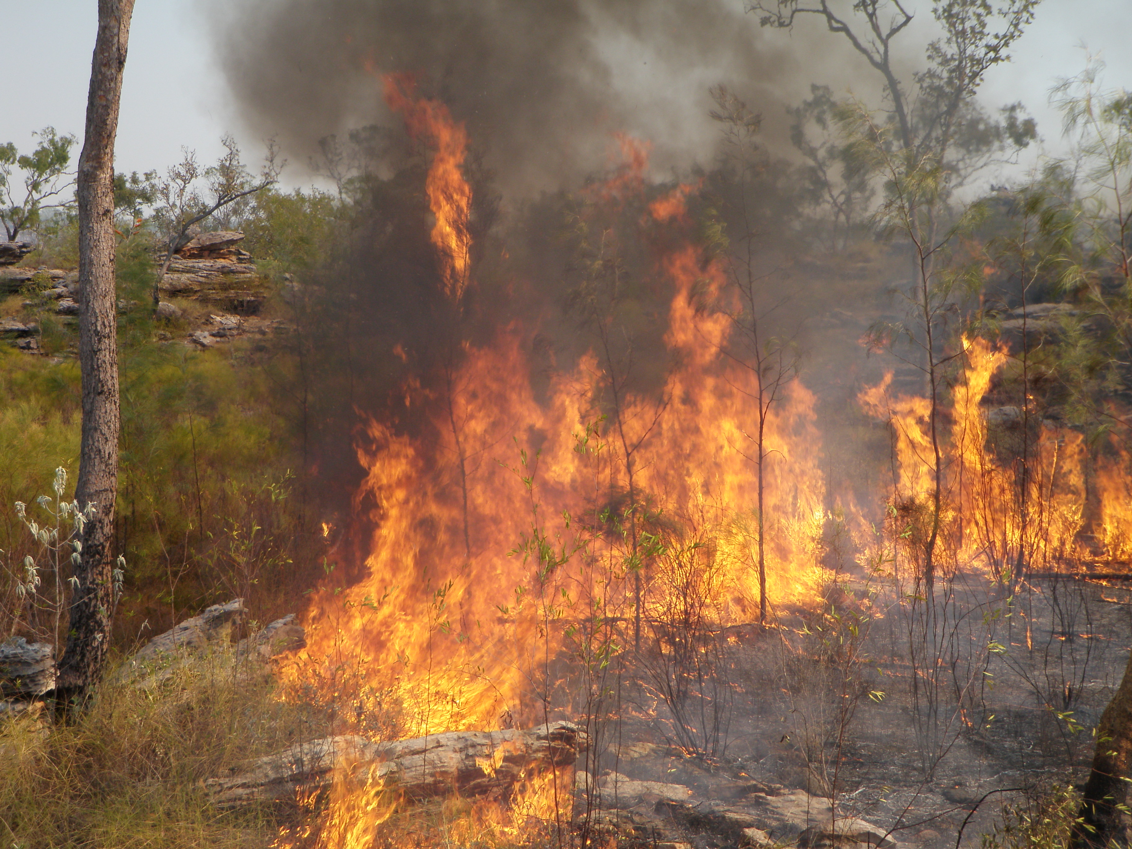

Burning Business
Indigenous Fire Management & Carbon Farming
A detailed guide on how to start your own
savanna fire management project

Slide 2
About this resource
Content
These slides are a guide on how to set up and run a carbon farming project,
  with a specific focus on a savanna fire management projects
It is based on the steps set up out by the Australian Government
  through a department called the Clean Energy Regulator. Click here for their website
The information applies to projects that will register and start operating after 1 July 2015
  but it is still applicable to projects that may have started planning earlier.
How to use
These slides do not have to be used a powerpoint.
  They are an educational resource that facilitators can ‘cut and paste’ according to individual requirements.
Whilst the information provided is detailed, it does not include all of the detail and supporting materials should be checked.
  Suggestions for improvements and requests for clarification are welcomed.
Words highlighted and underlined in blue are hyperlinks to the relevant internet website.
  Right click and select ‘open’ or the link is provided in the notes box below.
Words highlighted in green are common definitions
  Look up the meaning at the end of the slides.
Notes:
Website: http://www.cleanenergyregulator.gov.au/ERF/Want-to-participate-in-the-Emissions-Reduction-Fund

Slide 3
Disclaimer
We make every attempt to ensure accuracy, currency and reliability of the information contained in our documents.
NAILSMA Ltd accepts no responsibility for any inaccuracies in the information contained on this presentation and persons relying on this information do so at their own risk.

Slide 4
Table of Contents
Topic | Slides
Real world carbon farming project examples | 5 – 8
What are carbon farming projects? | 9
What are savanna fire management projects? | 10
What is the carbon market? | 11 – 12
What is the methodology? (A summary of the steps involved) | 13
Step 1: Plan | 14 – 28
Step 2: Register | 29 – 33
Step 3: Find a buyer | 34 – 42
Step 4: Run your project | 43 – 48
Step 5: Close your project | 49 – 51
Additional things to consider | 52
Transitioning Policies | 53
Definitions | 54 - 55
Contacts | 56
*click on the slide N# to go directly to the page

Slide 5
Real world examples
The colour spots on the map show that there are over 33 carbon farming projects in north Australia.
In these areas Indigenous land owners are using traditional-style fire management techniques to manage their land, create jobs, connect with community and make money

Slide 6
Real world example: WALFA
An important elder led his people back to manage the plateau country in west Arnhem Land. Using traditional knowledge, with the help of modern science, he and others found a way to reduce the frequency and intensity of wildfires.
In the early dry season rangers and partners use modern technology (like helicopters and drop torches) to do traditional-style patch burning. This creates a strategic mosaic of small burns that stop the big late dry season wildfires.
The pictures below are satellite images of west Arnhem land. The red marks are fire scars and shows the size of the wildfires. The picture on the left was taken before the project started whilst the picture on the right was taken after. It shows that the wildfires were much smaller now that they are managed.
Before
After

Slide 7
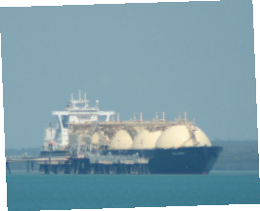
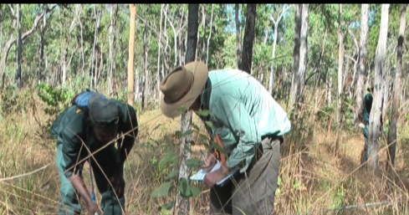
Real world example: WALFA
Conocco Phillips is a big gas company in Darwin that runs a liquefied gas plant which creates a lot of greenhouse gas emissions. To make up for these emissions (to offset them) they agreed to pay the people of Arnhem land to fund a savanna fire management project.
From 2006 – 2011 (5 years) the project has saved approximately 900,000 tonnes of greenhouse gas emissions. In turn they have been paid approximately $1 million dollars a year. This money helps run the project, provide jobs and support the community.
Conocco Phillips gas company
Using science to measure greenhouse gas emissions

Slide 8
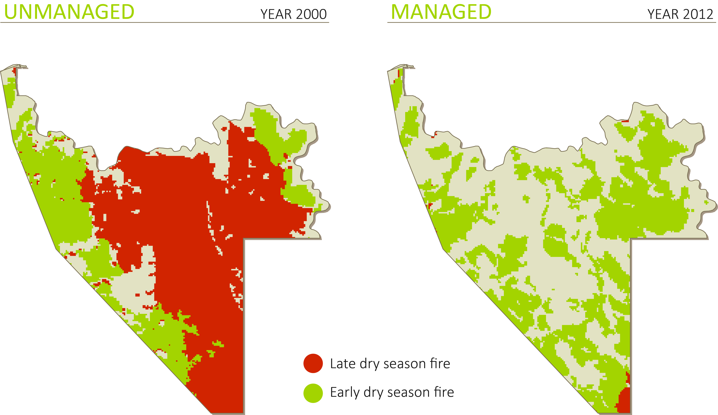
Case studies
Fire River Fire Project
Real world example: Fish River
The Indigenous Land Corporation (ILC) manages Fish River Station (NT) and has established the Fish River Fire Project to demonstrate how Savanna burning for abatement can establish a sustainable enterprise that not only :
  protects the property's significant biodiversity values, but also
  generates employment and income for Indigenous people.
The ILC has worked hard to make Fish River the first project approved as a savanna burning methodology, so it can act as a demonstration project.
Income from the sale of the credits are reinvested into land management on Fish River.
Before. Year 2000
After. Year 2012

Slide 9

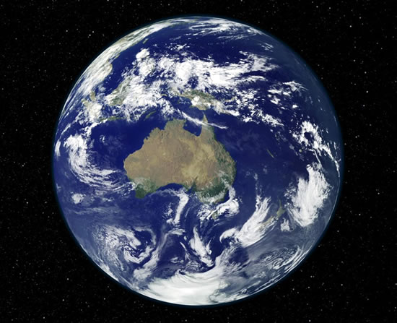
What are carbon farming projects?
The International Panel on Climate Change (IPCC) has confirmed that the climate is changing and the main cause is extra greenhouse gases (emissions) in the atmosphere released by human activities.
  E.g. burning coal and oil to run cars and create electricity
  E.g. clearing bush and forests to build cities and to grow crops and animals
In Australia one way to combat climate change is with carbon projects
It is where people or organisations change the way they do any type of business to reduce (sequest) or avoid (abate) emissions.
There are many types of projects that can be done, but some projects are specifically designed for people working and living on country and the land. These are referred to as carbon farming projects.

Slide 10
What are savanna fire management projects?
One type of carbon farming project is a savanna fire management project.
In this project people can use fire in a controlled way to manage the land. This way they can reduce the size and frequency of unmanaged wildfires and therefore reduce the amount of emissions
To run this project it must follow a methodology. A methodology is a step by step guide and includes a strict set of rules.
The methodology has been made using a combination of indigenous knowledge and western science. Indigenous people have been using fire for thousand of years to manage land and now modern science has developed technology that can measure how many emissions go into the air from fires.

Slide 11
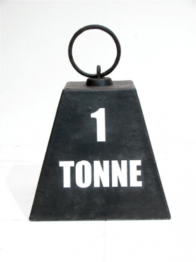
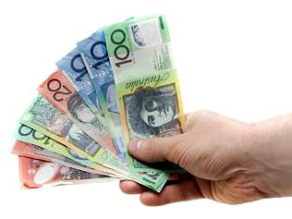

What is the carbon market?
For every tonne of emissions (referred to as tonne of carbon dioxide equivalents or t/CO₂e) that a project sequests or abates it can receive a carbon credit.
A carbon credit can be sold into a carbon market for money $$. A carbon market is similar to other markets where you buy and sell goods
Carbon credits made in Australia are called Australian Carbon Credit Units (ACCU)
Policy/ rules surrounding how ACCUs are made, bought and sold have changed many times in Australia.
Since 2015, the policy is called the ‘Direct Action Plan’ and under this policy an ACCU can be sold to;
  Option A: The Australian Government (the primary market)
  Option B: Private organisations (the secondary market)
1 tonne of CO₂e
1 ACCU
(1 carbon credit)
Sold for $

Slide 12
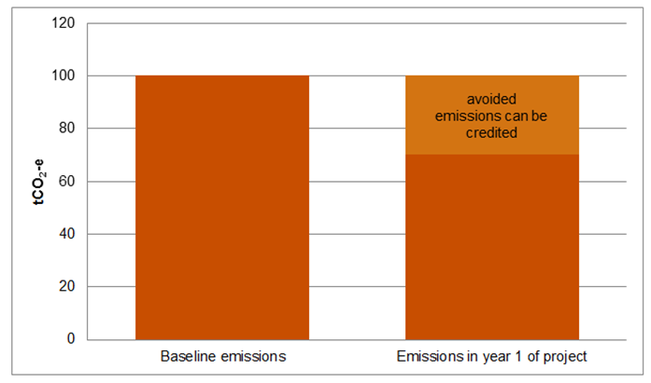
What is the carbon market?
The amount of carbon credits your savanna fire management project can sell depends on how many tonnes of CO₂e it reduces compared to before your project starts (when there were unmanaged wildfires).
This is called the baseline.
In other words the baseline represents what would happen (how many emissions would be released into the atmosphere) if you didn’t do the project.
You can measure the baseline using science, and this process is described in the methodology.

Slide 13
What is the methodology?
Step 1: Plan your project
  Methodology assessment
  Eligibility assessment
  Legal assessment
  Financial assessment
  Social assessment
Step 2: Register
  Pick a project applicant
  Complete forms
  Submit forms
Step 3: Find a buyer
  Option A: The Government
  Option B: Private Organisations
Step 4: Run your project
  Operational plans
  Monitor + Evaluate
  Keep Records
  Make Project Reports
  Claim your ACCUs
Step 5: Close your project
  End
  Withdraw
  Alter
There are five key steps in the methodology
The following slides will explain each step and its sub-steps so you know what is involved to start your own project. →

Slide 14
Step 1: Plan your project
Step 1: Plan your project
  Methodology assessment
  Eligibility assessment
  Legal assessment
  Financial assessment
  Social assessment
Step 2: Register
  Pick a project applicant
  Complete forms
  Submit forms
Step 3: Find a buyer
  Option A: The Government
  Option B: Private Organisations
Step 4: Run your project
  Operational plans
  Monitor + Evaluate
  Keep Records
  Make Project Reports
  Claim your ACCUs
Step 5: Close your project
  End
  Withdraw
  alter
This step is to help you decide whether a savanna fire management project is right for you and your country (is it feasible?).
Traditional owners can perform the following feasibility assessments, and if needed they can work with others (scientists, Land Councils, Lawyers etc).

Slide 15
Step 1: Plan your project
  Methodology assessment
  Eligibility assessment
  Legal assessment
  Financial assessment
  Social assessment
You must determine if a project on your country will be able to match the methodology. The methodology for savanna fire management projects is described in words and set out in a legal document available here
If you prove to the Clean Energy Regulator that your project can follow the methodology you can prove that your project will actually reduce tonnes of CO₂e which means you can ‘claim’ an ACCU for each tonne your project sequests or avoids.
A useful online tool to help you follow some steps in the methodology is called SavBAT2. It is an computer program created by the government that will help you make the required maps (described on the following slides)
This step can also be done manually, without the tool, as long as you are able to provide the right information.
Notes:
‘Here’ Methodology law link: https://www.comlaw.gov.au/Details/F2015L00344
‘SavBAT2’ tool link: http://savbat2.net.au/#/welcome – (do a demo)

Slide 16
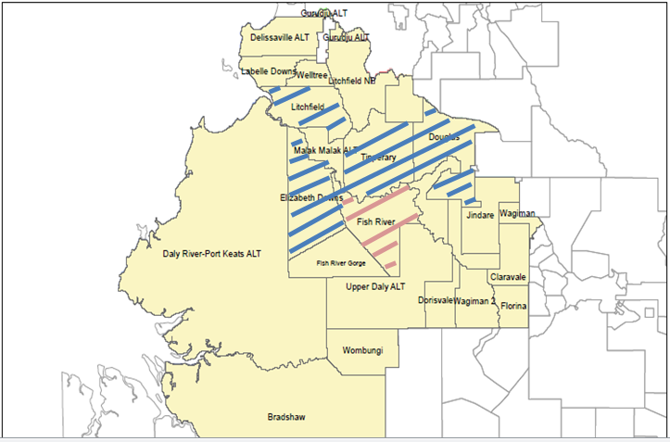
Step 1: Plan your project
  Methodology assessment
  Eligibility assessment
  Legal assessment
  Financial assessment
  Social assessment
Map the legal boundaries (land tenures)
Find out how the land is ‘held’ and by who
  E.g. it is exclusive or non exclusive native title land? Are there any pastoral leases?
Consider the influence of the other land holders upon your project
Information can be obtained from:
  Indigenous Land Corporation
  The Northern Land Council
  Central Land Council
  North Queensland Land Council
  Cape York Land Council
  Kimberly Land Council
  Land Title Office (Northern Territory)
Notes:
The above map shows some land parcels registered for Savanna Burning Projects.
‘Indigenous Land Corporation’: http://www.ilc.gov.au/Home/Offices
‘The Northern Land Council’: http://www.nlc.org.au/contact/
‘Central Land Council: http://www.clc.org.au/
‘North Queensland Land Council: http://nqlc.com.au/
‘Cape York Land Council: http://www.cylc.org.au/
‘Kimberly Land Council’: http://www.klc.org.au/
‘Land Title Office’: http://www.nt.gov.au/justice/bdm/land_title_office/

Slide 17
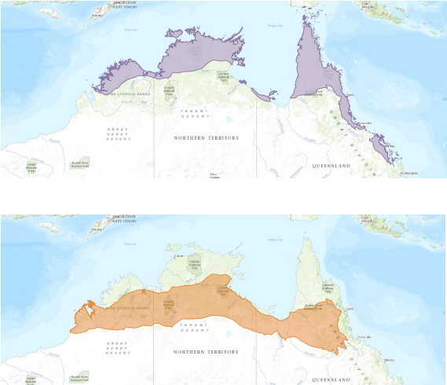
Step 1: Plan your project
  Methodology assessment
  Eligibility assessment
  Legal assessment
  Financial assessment
  Social assessment
Map the rainfall
To know if your country is suitable for the
  ‘low rainfall’ (between 600-1000mm) or
  ‘high rainfall’ (greater than 1000mm) methodology
Download the rainfall maps from here
High rainfall region
Low rainfall region
Notes:
‘here’ Rainfall maps: http://www.environment.gov.au/climate-change/emissions-reduction-fund/methods/savanna-burning

Slide 18
Step 1: Plan your project
  Methodology assessment
  Eligibility assessment
  Legal assessment
  Financial assessment
  Social assessment
Map the vegetation
Your land must contain at least one of the vegetation types listed in the methodology (see table)
You must provide a GIS vegetation map at 1:1,000,000 scale
Vegetation maps can be obtained from;
  The Darwin Centre for Bushfire Research who can provide Satellite based MODIS and LANDSAT vegetation or fuel structure maps
  If in Queensland, the Department of Natural Resources and Mines
  If in Western Australia, ……
  If in the Northern Territory, …….
For high rainfall methodologies | For low rainfall methodologies
Eucalypt open forest with tussock grass ground layer Eucalypt woodland with tussock grass ground layer Sandstone woodland with a mixed tussock and/ or hummock (Spinifex)) grass ground layer; and Sandstone health with a ground layer dominated by hummock grasses (Spinifex) | Woodland with tussock grasses Woodland with mixed tussock/ hummock grasses Open woodland with mixed grasses Shrubland with hummock grasses
Notes:
‘The Darwin Centre for Bushfire Research’; http://riel.cdu.edu.au/contact-us
Qld ‘Department of Natural Resources and Mines’: https://www.dnrm.qld.gov.au/forms/land-property/vegetation-map-request

Slide 19
Step 1: Plan your project
  Methodology assessment
  Eligibility assessment
  Legal assessment
  Financial assessment
  Social assessment
Map the fire scars
To determine how large and how often the wildfires have occurred on your country in the past (the baseline)
For the high rainfall method, the baseline data is the total average yearly greenhouse gas emissions that was generated in the 10 years immediately before your project started, when there was no substantial fire management over the project area. Fuel estimation looks at five years earlier while fuels were building up. You therefore need to look at 15 years of fire mapping.
Fire scar maps can be obtained from;
  The North Australian Fire Information website for Satellite-based MODIS maps
  The Darwin Centre for Bushfire Research
Notes:
‘The North Australian Fire Information’: http://www.firenorth.org.au/nafi3/
‘The Darwin Centre for Bushfire Research’: http://riel.cdu.edu.au/contact-us

Slide 20
Step 1: Plan your project
  Methodology assessment
  Eligibility assessment
  Legal assessment
  Financial assessment
  Social assessment
  If your project area matches the requirements of the methodology you can continue planning
  Use all the mapping to work out:
    Emissions for the last 10-15 years (the baseline)
    Whether it looks possible to reduce the areas burned in late dry season fire (after 1 August) and/or the total amount of fire
    How much you reckon you could change the fire
    How many tonnes of CO₂e you reckon you could abate and thus how many ACCUs you could create

Slide 21

Step 1: Plan your project
  Methodology assessment
  Eligibility assessment
  Legal assessment
  Financial assessment
  Social assessment
Your project must meet 3 eligibility requirements;
The newness requirement
  The project must be ‘new’.
  You can not have already started the project and started burning (unless you started a project under the old regulations and are transitioning, see slide ?)
The additionality requirement
  The project must be not be required to be carried out under any other Government law.
  E.g. the million tree planting program.
The government program requirement
  It must be likely that the project will not be required to be carried out under another government program.
Notes:
‘Eligibility requirements’: http://www.cleanenergyregulator.gov.au/ERF/Want-to-participate-in-the-Emissions-Reduction-Fund/Planning-a-project/Eligibility-additionality-and-newness

Slide 22
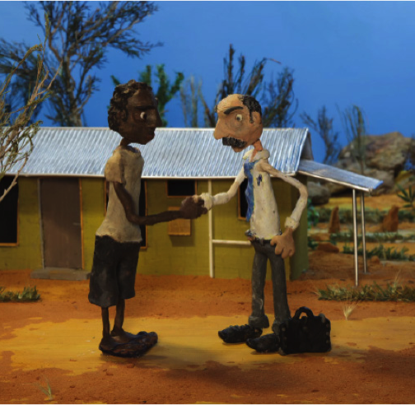
Step 1: Plan your project
  Methodology assessment
  Eligibility assessment
  Legal assessment
  Financial assessment
  Social assessment
When you mapped the legal boundaries of the land it may reveal that there are many stakeholders impacted and involved in your project, e,g. different landowners and land lessees.
You must prove you have the ‘legal right’ to carry out the project.
All of the stakeholders must come to a agreement that they accept the project, and what their role will be.
To obtain legal right you must provide in writing;
  A description of the project activities and associated obligations
  An official statement that you have the right to carry out the project and the lawful and exclusive right to be issued the ACCUs
  A written explanation of how you acquired the legal right plus any supporting documents
  A statement about the duration of the legal right
Notes:
‘Legal Right’: http://www.cleanenergyregulator.gov.au/ERF/Want-to-participate-in-the-Emissions-Reduction-Fund/Planning-a-project/Legal-right

Slide 23
Step 1: Plan your project
  Methodology assessment
  Eligibility assessment
  Legal assessment
  Financial assessment
  Social assessment
  If you are doing an area-based emissions abatement project (e.g. savanna burning) or a sequestration project (e.g. tree planting) you also need to officially obtain the consent of all other persons or organisations holding interest in the land by filling in a ‘Eligible Interest Holder Consent Form’
  You can download the form here
  Who holds ‘legal interest’ varies from State- to- State so make sure you check what applies to you by looking at section 43 to 45 of the law here or by referring to the same organisations listed on slide 12
Notes:
‘here’; download form: http://www.cleanenergyregulator.gov.au/DocumentAssets/Pages/Eligible-interest-holder-consent-form.aspx
‘here’: legal interest law: https://www.comlaw.gov.au/Details/C2015C00260
Northern Land Council (NLC) Section 19 Land Use Agreements
(Aboriginal Land Rights Act ALRA) gives traditional owners an opportunity to consider, develop terms and conditions and the right to consent to or reject proposals on their land. In Western Australia or Queensland, tenure will usually fall under Native Title Indigenous Land Use Agreements (ILUA). If you are the non-exclusive native title holders of the land then (unless your legal right to carry out the project is recognised in a consent determination as part of your native title) you will need to enter into an Interested Parties Agreement with the other land owners or land interest holders (e.g. pastoral lessee, government agency or authority if reserved for conservation or Aboriginal people.)

Slide 24
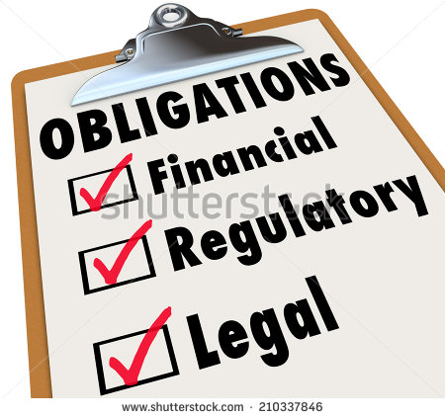
Step 1: Plan your project
  Methodology assessment
  Eligibility assessment
  Legal assessment
  Financial assessment
  Social assessment
It is also important that you understand your legal obligations for running a project.
Failure to comply may result in a penalty.
This includes, but is not limited to;
  Record keeping, reporting and auditing
  Maintaining legal right (e.g. is it likely some stakeholders might change their minds?)
  Notifying the Clean Energy Regulator about any changes
Notes:
Legal obligations: http://www.cleanenergyregulator.gov.au/ERF/Want-to-participate-in-the-Emissions-Reduction-Fund/Planning-a-project/participant-obligations

Slide 25
Step 1: Plan your project
  Methodology assessment
  Eligibility assessment
  Legal assessment
  Financial assessment
  Social assessment
To figure out if the project is financially feasible you need to estimate your return on investment – how much profit you can make.
This is called a forward abatement estimate, more instruction on how to perform one can be found here
Even if you don’t make a large profit, you want to at least make sure the cost of running the project is covered
Estimated income from selling ACCUs
Estimated costs to run the project
Total profit
Estimate how many tonnes of CO₂e you will abate each season, and for up to the next 25 years
And multiply X this by
The estimated price for a ACCU. You can get a rough estimation by looking at what price was paid at the last auction (e.g. in April it was $13.25)
To estimate cost add together all the expenses For example:
  Wages (pay rangers)
  Equipment
  Use of vehicles
  Helicopters
  Fire drips
  Expert advice from lawyers and scientists
Notes:
‘here’ Forward Abatement estimate information: http://www.cleanenergyregulator.gov.au/ERF/Want-to-participate-in-the-Emissions-Reduction-Fund/Step-1-Apply/Forward-abatement-estimates

Slide 26
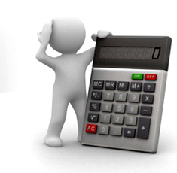
Step 1: Plan your project
  Methodology assessment
  Eligibility assessment
  Legal assessment
  Financial assessment
  Social assessment
Some of the important costs to consider are:
Legal
  do you have funding for legal advice, drawing up agreements and incorporation?
Planning
  Do you have funding support for project design and application costs.
  maybe for financial advice and modelling to see what the price of credits needs to be for your project to be feasible.?
Project establishment
  how much money will you need to establish the project before you start getting incomes?
Administrative
  Do you have the organisational skills, expertise and governance arrangements to monitor and manage projects?
Operational
  in addition to the big costs in wages and helicopters, trucks etc, how much will ongoing technical and scientific support and other equipment cost? Have you taken account of the costs of record keeping, monitoring and data management?
Commissions
  many of the organisations that may offer to design or run your project will need to be paid to do the work involved. Charges will vary depending on the organisation and how much you ask them to do, but can be a substantial part of the potential income. You will need to consider these sorts of costs in choosing.
Risk management
  If you have a bad year and don’t hit your targets for abatement, how much will you need to set aside?

Slide 27
Step 1: Plan your project
  Methodology assessment
  Eligibility assessment
  Legal assessment
  Financial assessment
  Social assessment
If it looks like there is a chance that you are short on money you could…
Seek separate funding from other sources. E.g. NGO’s or the government
‘Aggregate’ (join together) your project with other projects, to help share costs and knowledge. You can aggregate projects that have the same or different methodologies. Click here for more information.
Seek expert advice. It must come from people familiar with ‘carbon markets’
Notes:
‘here’ for info on aggregation: http://www.cleanenergyregulator.gov.au/ERF/Want-to-participate-in-the-Emissions-Reduction-Fund/Planning-a-project/Aggregation-under-the-Emissions-Reduction-Fund

Slide 28
Step 1: Plan your project
  Methodology assessment
  Eligibility assessment
  Legal assessment
  Financial assessment
  Social assessment
  You also need to consider the good and bad impacts the project could have on you, other people and community, in the short term and in the long term
  Make sure all people belonging to your country agree with setting up the project and understand all the opportunities and issues and can voice their views.
  Consult with everyone and use maps to help explain
  Some thing to consider during consultation are;
    Who will run the project now and into the future? Is there a land manager group (i.e. ranger group) available
    In changing fire how do you make sure that you can continue other important land uses like hunting, or ceremony?
    Will future generations be able to take on the responsibility ?
    How the costs and benefits will be sourced, managed and distributed fairly
    What will be done with any ‘left over’ / profit money?
  When an agreement has been met, make it formal an in writing

Slide 29
Step 2: Register your project
Step 1: Plan your project
  Methodology assessment
  Eligibility assessment
  Legal assessment
  Financial assessment
  Social assessment
Step 2: Register
  Pick a project applicant
  Complete forms
  Submit forms
Step 3: Find a buyer
  Option A: The Government
  Option B: Private Organisations
Step 4: Run your project
  Operational plans
  Monitor + Evaluate
  Keep Records
  Make Project Reports
  Claim your ACCUs
Step 5: Close your project
  End
  Withdraw
  Alter
After planning, if you decide that the project is right for you and your country, the next step is to apply to the Clean Energy Regulator to register the project officially and formally.
This step involves
  Picking a project applicant
  Completing lots of forms and paper work about your project, based off information gained during step 1:Plan
  Submitting the forms to the Clean Energy Regulator

Slide 30



Step 2: Register
  Pick a project applicant
  Complete forms
  Submit forms
You need to pick a suitable ‘applicant’
They will be the official project owner and will be largely responsible for the project, completing forms, and communicating with the Clean Energy Regulator.
They can be one of the following:
    Individual
    Organisation
    Public/private company
    Other Incorporated Entity
      Local, State and Territory government bodies
      A Trust
  They must prove to you that they have the skills to put together a good quality project and application and will act in your best interests at all times.

Slide 31
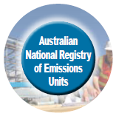
Step 2: Register
  Pick a project applicant
  Complete forms
  Submit forms
The applicant will need to complete the following forms;
  Project Application form
  Project Application for Area Based Project form
  Client Information form (to prove that your applicant is ‘fit and proper’ – trusted with no criminal history)
    Australian Federal Police national police check form
    certified copies of identification document
    list of authorised signatories - if a company
    others as necessary
  Application form for an ANREU account (this is like an electronic bank which the ACCU’s are exchanged)
All forms can be downloaded here
Or you can complete the forms through an online portal here
Notes:
‘here’ Applicant forms: http://www.cleanenergyregulator.gov.au/ERF/Forms-and-resources/apply-to-participate
Portal here: http://www.cleanenergyregulator.gov.au/OSR/CP/Pages/default.aspx

Slide 32

Step 2: Register
  Pick a project applicant
  Complete forms
  Submit forms
The applicant will need all the details obtained during the previous planning stage to complete the forms. In summary this includes;
  A name for the project
  A nominated start date
    this will usually be the beginning of a calendar year (e.g. 1 January 2016) because the methodology estimates emissions in calendar year blocks
  A brief description of the location
  Proof that your using a applicable methodology
    a list of geospatial files and the files themselves
    detail of vegetation fuel type map and evidence of validation
    Estimation of baseline emissions
  Proof of legal right
  Eligible interest holder consent
  Proof of meeting eligible criteria
  Return on investment (profit) summary
  A Forward Abatement Estimate of 25 years
    this figure is so important that it should be checked again before including it in the application
    as well as indicating potential incomes, it is used by government to determine how often the project should be audited, which will affect project costs
  Regulatory approvals
    Savanna fire projects will usually require approvals from fire management authorities prior to burning
    permits are not issued far in advance, so the regulator may register the project subject to getting permits nearer the burning activity
    even though not strictly required, it will be good practice to discuss your intentions with fire authorities during planning and prior to lodging an application

Slide 33


Step 2: Register
  Pick a project applicant
  Complete forms
  Submit forms
Submit forms to the Clean Energy Regulator for approval to register the project
  When a decision has been made, you will be notified in writing and your project’s details will be published on the ERF Register.
  This is known as Market Entry

Slide 34
Step 3: Find a buyer
Step 1: Plan your project
  Methodology assessment
  Eligibility assessment
  Legal assessment
  Financial assessment
  Social assessment
Step 2: Register
  Pick a project applicant
  Complete forms
  Submit forms
Step 3: Find a buyer
  Option A: The Government
  Option B: Private Organisations
Step 4: Run your project
  Operational plans
  Monitor + Evaluate
  Keep Records
  Make Project Reports
  Claim your ACCUs
Step 5: Close your project
  End
  Withdraw
  Alter
Under the most recent laws (the Direct Action Plan) carbon projects can sell their ACCUs to;
  The Australian Government
    Who use money from the emissions reduction fund
  Private Organisations
    E.g. ConocoPhilips the Liquefied Natural Gas plant in Darwin

Slide 35

Step 3: Find a buyer
Option A: The Government (primary market)
Option B: Private Organisations (secondary market)
The Australian Government must reduce Australia’s overall emissions according to an internationally binding law called the ‘Kyoto Protocol’
The Australian Government uses a big pool of money called the Emissions Reduction Fund to buy ACCUs from Australian carbon projects. The government decides how many ACCUs it will buy and from which projects at a reverse auction.
In a reverse auction, those running the carbon projects must compete/bid against each other to offer the most carbon credits at the cheapest price.
Those projects that win, enter into a contract with the government to deliver a certain amount of ACCUs over a certain time period
A Government organisation called the Clean Energy Regulator regulates/ looks after the auction process and the distribution and purchase of ACCUs
Click here for a video introduction to the process.
Notes:
‘here’ for video: https://youtu.be/4mWs9_8ncRc

Slide 36
There are 5 sub- steps
Step 1: Plan for Action
There is a guide online to help you with claiming and selling ACCU’s
Always seek professional advice
Step 3: Find a buyer
Option A: The Government (primary market)
Option B: Private Organisations (secondary market)
Check the Clean Energy Regulator website for when the next auction will be.
  They publish a rough schedule 6 weeks before.
Decide on a price to offer the government for your ACCUs
  Make sure the price of your ACCU bid is less than the ‘benchmark price’ (a price set by the Clean Energy regulator which will be advertised)
  Your chance of success is higher if you can offer the largest amount of ACCUs, for the lowest price. Remember you are competing against other carbon projects.
  Consider what prices have been paid in earlier auctions. Can you go as low as that and still cover all your costs?
  Consider and compare what prices are like in voluntary markets
  if you bid too high and miss out on a contract, do you have the money to keep the project going until the next auction?
How confident can you be about reaching your target?
  how variable are the fire histories on your lands: do you often have really bad years with lots of fire?
  have others in your region doing projects been successful in getting control and reliably meeting targets, or have they found it hard
  have you got everything you need in place, including experienced staff?
Figure out how you should manage risk of ups and downs in ACCUs produced.
  by offering only some of the credits that you think you can produce and keeping some in reserve for later sale if work goes well?
  by going for a short contract in your first bid, and going for longer contracts when you are more confident?
Notes:
Guide: http://www.cleanenergyregulator.gov.au/ERF/Forms-and-resources/auctions-and-contracts
ERF website: http://www.cleanenergyregulator.gov.au/ERF/Pages/default.aspx

Slide 37

Step 3: Find a buyer
Option A: The Government (primary market)
Option B: Private Organisations (secondary market)
There are 5 sub- steps
Step 2: Qualify to participate in the Auction
Submit an ‘Auction Qualification Form, at least 20 business days before the Auction
This includes information about:
  a contract length;
    A 7 year contract
    A short term contract (7 years or less)
    A immediate contract duration (carbon credits delivered upon signing contract – so before project starts)
    Long term contract (10 years)
  Project registration
  Indication the number of credits you are likely to offer
  Indication of price you will offer
  Any other conditions
Click here for a link to a video explaining this step about ‘contracts and auctions’
Notes:
‘Auction Qualification Form’: http://www.cleanenergyregulator.gov.au/DocumentAssets/Pages/CER-ERF-AUC001---Auction-Qualification---Commercial-Terms.aspx
‘here’ for video: https://youtu.be/67E8s3v_klw

Slide 38

Step 3: Find a buyer
Option A: The Government (primary market)
Option B: Private Organisations (secondary market)
There are 5 sub- steps
Step 3: Register for a specific auction
Submit an ‘Auction Registration Form’, at least 5 business days before the auction.
This includes information about:
  which auction you are to bid in,
  a firm commitment to the number of credits,
  a schedule for delivery (how many and when) and
  any other conditions.
Notes:
‘Auction registration form’: http://www.cleanenergyregulator.gov.au/DocumentAssets/Pages/CER-ERF-AUC002---Auction-Registration---Delivery-Terms.aspx

Slide 39

Step 3: Find a buyer
Option A: The Government (primary market)
Option B: Private Organisations (secondary market)
There are 5 sub- steps
Step 4: Participate in the bid
On the day/ time of auction, submit your bid through the online bidding platform called ‘Aus tender’(click for a link to a video tutorial).
Do not tell anyone about the details of your bid or your strategy!
If you are not going to do the bidding yourself as the applicant you need to submit this‘Auctions Authorised Bidder’ Form. This sets out who you nominate to bid for you. You need to make sure this is a person with the right knowledge & skills.
There is no way to submit late bids
A sample bid form is available here for guidance.
Notes:
‘Aus tender’: https://youtu.be/-ENhGLoby3A
‘Auctions Authorised Bidder’: http://www.cleanenergyregulator.gov.au/ERF/Forms-and-resources/auctions-and-contracts
‘here’ for bid for: http://www.cleanenergyregulator.gov.au/DocumentAssets/Pages/Sample-bid-form.aspx

Slide 40

Step 3: Find a buyer
Option A: The Government (primary market)
Option B: Private Organisations (secondary market)
There are 5 sub- steps
Step 5: Enter into a contract
The Clean Energy Regulator will notify if you have been successful within 5 days of the auction
If you are NOT successful
  try again at the next auction, or look for a private organisation to buy your ACCUs.
If you are successful
  a ‘carbon abatement contract’ with the government is effective immediately
  Depending on your contract, you can be paid for your ACCUs in advance, based on your forward abatement estimate.
The contract is serious business. There is not much flexibility.
There are penalties for failing to deliver by the end of the contract period.
  You might be asked to pay government for any under delivery at the present credit price.
  You might have to buy more carbon credits from other projects to make up for it.
  You should participate in auctions only if you are really confident about your project and have worked out how to manage problems like more bad (high fire) years than usual during the contract period
The advantage of participating in the ERF is that you can get a long term contract to buy at a price you know can meet your costs (because you set your bid that way).
Notes:
Carbon abatement contract: http://www.cleanenergyregulator.gov.au/DocumentAssets/Pages/Carbon-Abatement-Contract.aspx

Slide 41

Step 3: Find a buyer
Option A: The Government (primary market)
Option B: Private Organisations (secondary market)
There are two steps:
Step 1: Find a buyer
The secondary market is where you sell your ACCUs to:
  A organisation that may need to buy ACCUs because they create a lot of pollution and must by law offset their own emissions
    (full details about this will be released in 2016)
  A private organisation who does not have to buy ACCUs by law but does so for voluntary reasons such as;
    they are committed to good environmental practice
    they want to create or enhance their reputations for ethical practice
    They want to support local communities
    They want to by carbon credits that produce social and biodiversity benefits as well
  Another carbon project who did not produce enough ACCUs (did not meet their contract) so must buy ACCUs from other projects to make up for it.
  Carbon brokers who want to buy up ACCUs to sell on to other buyers who need or want them for investment purposes.
You may want to sell your ACCUs here when:
  You tried to sell your ACCUs to the government at the auction but were not successful
  You sold your ACCUs to the government at the auction, but produced more ACCUs than expected and you have left overs that you want to sell (but the government wont buy because it wasn’t in the original contract).
  A private organisation can off you’re a better price, is willing to go into a longer contract with you or is willing to have a more flexible contract.

Slide 42
Step 3: Find a buyer
Option A: The Government (primary market)
Option B: Private Organisations (secondary market)
There are two steps
Step 2: Enter into a contract
    Sales will occur under a private commercial agreement.
      The government will have no involvement in or oversight of these agreements.
      The price of ACCUs in this market will be a matter of direct negotiation between you and the organisation
    Make sure you get good financial advice when you are doing this!
    Prices can vary through time
      depending in part on supply (how many carbon credits are available from other projects),
      but you might expect to get close to the average price paid at the last auction.
    You may want to do this process through a third party – a broker, bank or trader.
      Brokers need to have an Australian Financial Services License (AFSL) and are financial services providers who can arrange the sale of ACCUs, and organise collective pools of ACCUs to access wholesale market prices
    You do not have to sell all your ACCU’s at once and to one person.
      You could hold onto them and wait until you can get a better price, or keep them in case you fall short of your contract amount in the future

Slide 43
Step 4: Run your project
Step 1: Plan your project
  Methodology assessment
  Eligibility assessment
  Legal assessment
  Financial assessment
  Social assessment
Step 2: Register
  Pick a project applicant
  Complete forms
  Submit forms
Step 3: Find a buyer
  Option A: The Government
  Option B: Private Organisations
Step 4: Run your project
  Operational plans
  Monitor + Evaluate
  Keep Records
  Make Project Reports
  Claim your ACCUs
Step 5: Close your project
  End
  Withdraw
  Alter
Four key things to consider in running your project
  Develop + implement operational plans
  Monitor and evaluate project to ensure it is following the methodology and improving
  Keeps records to create ‘project reports’ which will be audited
  Use ‘project reports’ and ‘audit reports’ to claim for ACCUs
The rules for how you do these steps will depend on your contract, and who you buyer is/ who you are selling to.

Slide 44

Step 4: Run your project
  Operational plans
  Monitor + Evaluate
  Keep Records
  Make Project Reports
  Claim your ACCUs
Let everyone involved know you have approval and are going to start.
Start detailed operational planning, well before the start of the next fire season. This includes:
  bringing together all of the mapping
  setting up record keeping systems
  working out who to involve in pre-season planning
  scheduling planning meetings
  buying or assembling equipment and ensuring that it is in good condition
  speaking to others whose services you may need – like helicopter operators
Develop an annual operations plan for the Early Dry Season (EDS)
  in collaboration with all interested parties
Implement your plan
  Inform neighbours and other interests, including local Bushfires authorities about the operational plan

Slide 45

Step 4: Run your project
  Operational plans
  Monitor + Evaluate
  Keep Records
  Make Project Reports
  Claim your ACCUs
Monitor and evaluate your project on a regular basis so you know how it is going and you can improve it.
  Monitor the success of the EDS plan through NAFI and on ground work
  Adjust burning as necessary
  Monitor the success of the EDS plan through NAFI and on ground work
  Adjust burning as necessary
  Maintain a watch to detect unplanned fires, especially during the late dry season
  Respond to unplanned fires, where needed, to contain them or put them out
  Record all activity to go into annual reports
  Keep all interests informed of activities
  Assemble records of activity, fire maps and estimates of abatement into reports for all participants and other interests, and to the regulator.
The annual task of fire mapping is usually done at the end of the year during project accounting.
Activity accounting is complex and often done by an external service provider.

Slide 46
Step 4: Run your project
  Operational plans
  Monitor + Evaluate
  Keep Records
  Make Project Reports
  Claim your ACCUs
You must keep the following records to create ‘project reports’
  They will be audited (checked by the Clean Energy Regulator) who will then create a ‘audit report’.
The types of records to keep include;
  Validated maps of vegetation
  What you did, where you did it
  Copies of SavBAT 2 reports used to estimate emissions
  If SavBAT 2 is not used, copies of fire maps used in estimates and any audit reports covering those maps
  fuel consumption reports allowing estimates of how much fuel was used in project activities.
  These records must be kept for 7 years
  Many of these records will also be needed for the project’s own purposes, like paying wages, so they may not add too much to administrative workloads. But they must be kept in a readily accessible form for audit.
What if things change?
  Notify the Clean Energy Regulator in writing
    Change in the area on which the project is done
    Change in names of proponents
    Or a decision to stop the project
  Failure to do so could result in a penalty

Slide 47
Step 4: Run your project
  Operational plans
  Monitor + Evaluate
  Keep Records
  Make Project Reports
  Claim your ACCUs
A guide for Audits under the ERF is available here
A guide to claiming and selling ACCUs is available here
You must deliver project reports to the Clean Energy Regulator in order to;
  prove that you carried out the activities they said they would in the project declaration;
  show that those activities match the requirements of the methodology;
  summarise calculations of abatement achieved in the reporting period;
  Claim ACCUs
  Present all the supporting evidence to back up the claims including, in some years, independent audit reports.
  Provide the information needed to show all interests in the project how it is going, and to think about how to improve performance:
Reports must be done at least every 2 years
  But for Savanna Fire it must be done the shortest possible report must be done every year because the burning season occurs every year.
The first project report will always have to be audited.
  How many additional audits will be required will be set by the regulator.
  Smaller projects will require fewer audit than big ones.
Project reports must be submitted with a form
  in July 2015 it was still be developed but check here for updates.
Audits must be done by a registered greenhouse and energy (NGER) auditor
  a list of these auditors can be found here)
Make sure you understand the costs and time of preparing reports and having them audited and making them available to all your partners and collaborators.
Notes:
‘Here’ ERF Audit guide: http://www.cleanenergyregulator.gov.au/DocumentAssets/Pages/Guidance-on-Audits-under-ERF.aspx
‘Here’ ACCUS claiming and selling guide: http://www.cleanenergyregulator.gov.au/DocumentAssets/Pages/Claiming-and-Selling-ACCUs---guide.aspx
‘Here’ for updates: http://www.cleanenergyregulator.gov.au/ERF/Forms-and-resources/reporting-and-auditing
‘Here’ list of auditors: http://www.cleanenergyregulator.gov.au/DocumentAssets/Pages/Register-of-Greenhouse-and-Energy-Auditors.aspx

Slide 48

Step 4: Run your project
  Operational plans
  Monitor + Evaluate
  Keep Records
  Make Project Reports
  Claim your ACCUs
Submit the ‘project report’ and ‘audit report’ to the Clean Energy Regulator, according to your schedule
Submit a Claim for ACCUs form
  To prove that your project genuinely reduced CO₂e emissions
Provide any additional information required by the Clean Energy Regulator
You will then receive your Abatement Statement
ACCUs will be transferred into your ANREU Account
  Just the carbon credits, not any money

Slide 49


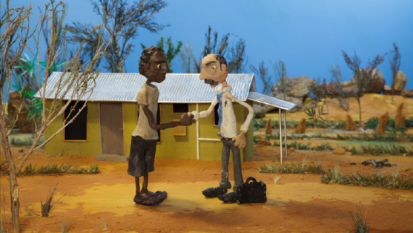

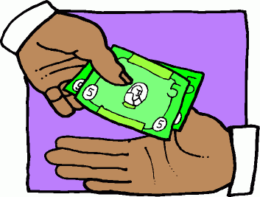



Find someone to enter into a contract with buy your estimated number of carbon credit’
Do the planning to make sure the Savanna burning project is right for you, country and community
Do all the paper work to register your project with the Clean Energy Regulator
  Sell your estimated carbon credits in advance
  Secondary market
  Primary market
  OR
  will buy from the lowest bidder at auction using money form the ERF
Sell your ‘carbon credits’ to your buyer at the agreed price + make up any differences
  Run your project + report your emission reductions once a year
  Sell to
  private organisations

Slide 50
Step 5: Close your project
Step 1: Plan your project
  Methodology assessment
  Eligibility assessment
  Legal assessment
  Financial assessment
  Social assessment
Step 2: Register
  Pick a project applicant
  Complete forms
  Submit forms
Step 3: Find a buyer
  Option A: The Government
  Option B: Private Organisations
Step 4: Run your project
  Operational plans
  Monitor + Evaluate
  Keep Records
  Make Project Reports
  Claim your ACCUs
Step 5: Close your project
  End
  Withdraw
  alter
There are 3 different ways you can close your project…

Slide 51
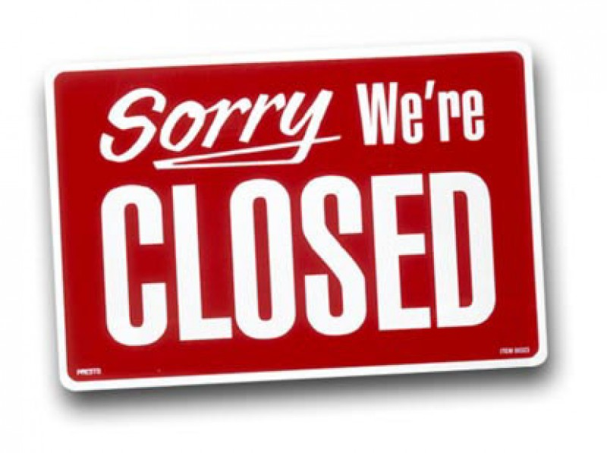
Step 5: Close your project
  End
  Withdraw
  alter
1. End your project completely
  End you project as normal at the end of the contract period
2. Withdraw your project early
  You can withdraw at any time but you will no longer be able to receive ACCUs
  Email the Energy Regulator at erf@cleanenergyregulator.gov.au and include;
    the project reference number
    the project title
    confirmation that you wish to withdraw the project, and
    your full name and contact details.
  Details can be found here in Part 3, Division 4 or the Carbon Credits Act 2011 law
3. Alter your project
  Apply to the Clean Energy Regulator by filling in the appropriate forms if you want to;
    Change the project area. Form
    Change the condition of project registration. Form
    Change the start date. Form
    Transfer the project to another project owner. Form
    Change the methodology used. Form
Notes:
‘here’ details of Act: https://www.comlaw.gov.au/Details/C2015C00260
Form: Project area: http://www.cleanenergyregulator.gov.au/DocumentAssets/Pages/Application-for-variation-of-registration---project-area.aspx
Form: project registration; http://www.cleanenergyregulator.gov.au/DocumentAssets/Pages/Application-for-variation-of-a-conditional-declaration-of-a-conditional-registration-of-a-project.aspx
Form: start date: http://www.cleanenergyregulator.gov.au/DocumentAssets/Pages/Application-to-vary-the-commencement-date-for-a-registered-project.aspx
Form: transfer: http://www.cleanenergyregulator.gov.au/DocumentAssets/Pages/Application-to-vary-the-scheme-participant-for-a-registered-project.aspx
Form: change methodology: http://www.cleanenergyregulator.gov.au/DocumentAssets/Pages/Application-to-use-a-different-method-for-a-project.aspx

Slide 52
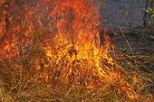
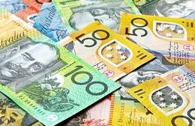
Additional things to consider
From the time you start planning, it can take up to 2 years to get the first payments for credits
  make sure you have the funds to cover all costs until then.
There is a risk of wildfires no matter how well you do the project
  you may want to consider holding back some of the ACCUs (so don’t sell all of them straight away) as reserves
  This way you still have income and don’t get hit with penalties because you haven’t been able to reach the emission reductions you estimated after bad years

Slide 53
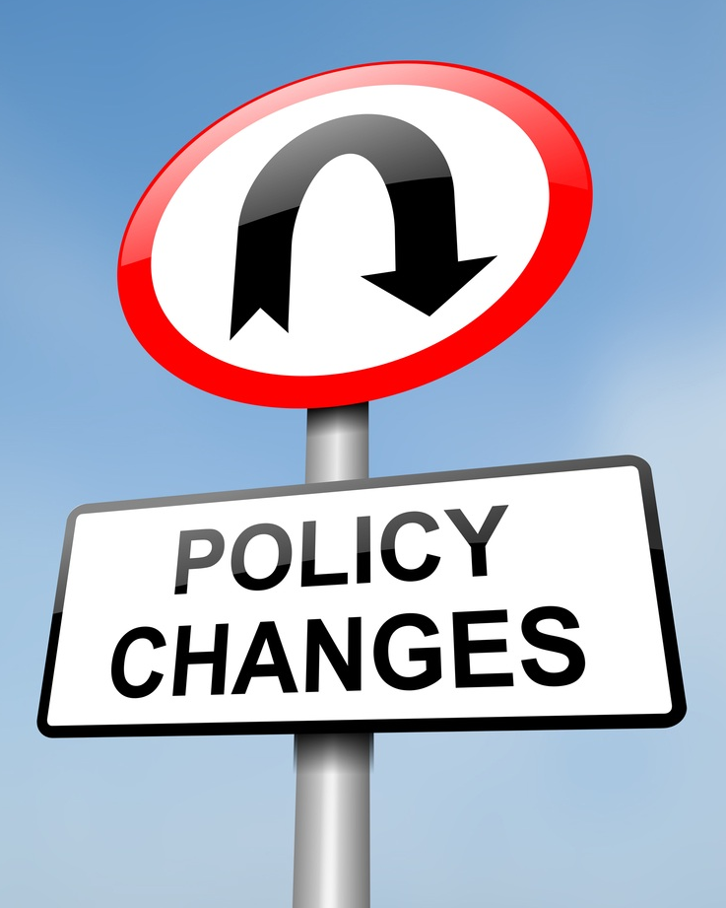
Transitioning policies
Transitioning Policies
We have shown the steps for new projects under the new policy. Some groups may have begun their projects under the old law and need to transition/ switch over. Here are your options;
Under the new law, existing Savanna fire management projects start a second crediting period of 25 years on the first day of January 2015.
You are not able to apply for further crediting periods under the Emissions Reduction Fund.
You can apply to claim ACCUs for abatement achieved under the CFI crediting period as well as the ERF crediting period.
Follow the new reporting frequency and audit frequency (see step 3)
Follow the new contract and auction processes if you wish to sell ACCUs to the government

Slide 54
Definitions
Word | Definition
Abate | To abate means to reduce the release of carbon into the atmosphere
Australian Carbon Credit Units (ACCU) | The name of carbon credits created in Australia. Issued by a government organisation called the Clean Energy Regulatory body
Baseline | The amount of greenhouse emissions produced before the project started e.g. when there was no fire management.
Carbon dioxide equivalents | Carbon dioxide is the most common greenhouse gas emission. That is why all other greenhouse gases have been categorized into a single value called ‘carbon dioxide equivalents’.
Carbon Credit | For every tonne of greenhouse gases that a project reduces of avoid, a carbon credit is issued. 40 tonnes of greenhouse gas = 40 carbon credits.
Carbon farming projects | Are projects that can be undertaken by people living on the land/ country to sequest or abate greenhouse gas emissions.
Carbon Market | A carbon market is where carbon credits can be bought or sold for money.

Slide 55
Word | Definition
Clean Energy Regulator (CER) | A government organisation that makes sure carbon farming projects are done correctly, including the distribution and purchase of ACCU’s at the reverse auction.
Emissions | A shortened term used to describe greenhouse gas emissions. Greenhouse gas emissions are invisible gases in the atmosphere that trap heat.
Emissions Reduction Fund (ERF) | A big pool of money that the government uses to buy as many ACCUs as possible from carbon projects all over Australia.
Forward Abatement Estimate (FAE) | The best estimate/ prediction of how many ACCU’s your project could create (how many tonnes of greenhouse gases it could reduce or avoid).
Methodology | A step by step guide on how to run a carbon farming project.
Offset | To offset carbon is about reducing greenhouse gases in one place to cancel out the same amount of greenhouse gases created in another place
Sequest | To sequest means to store or remove carbon from the atmosphere

Slide 56
Contacts
CER Clean Energy Regulator
enquiries@cleanenergyregulator.gov.au
1300 553 542
NAILSMA North Australian Indigenous Land and Sea Management Alliance Ltd
Glenn James
Policy and Program Manager
glenn.james@nailsma.org.au
0429120937
Land Council WA, NT, QLD

